Slide 1

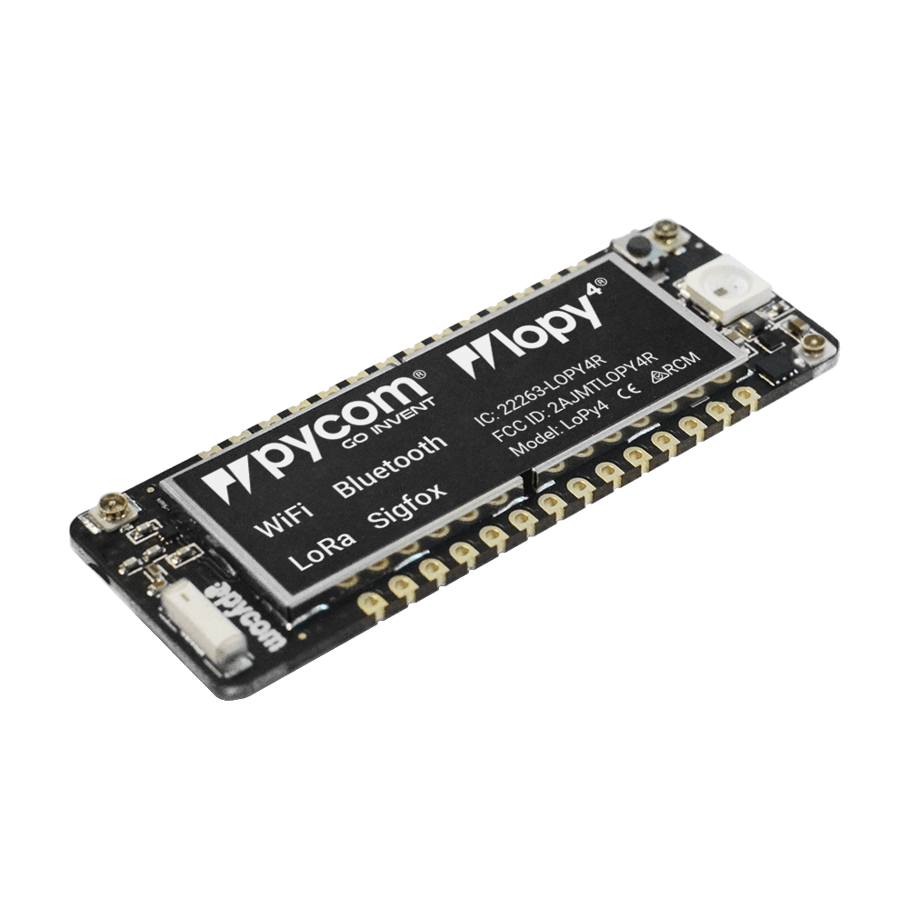
Lopy4 Prise en main
Jacques Chambon
https://github.com/jacquesChambon/Lopy4

Slide 2
Atelier Lopy4
Rappel sur les ateliers SoFab « IOT »
Présentation Lopy4
Description, architecture, caractéristiques
Préparation Hardware/Software
TP

Slide 3
Prochains ateliers SoFab « IOT » (à confirmer)
Jeudi 11/04 : Lopy4 (Jacques Chambon)
mardi 23/04 : Lora/Sigfox sur Lopy4 (Rémi Jolin)
mercredi 24/04 : The Things Network (TTN) (Fabien Ferrero)
Jeudi 25/04 : Présentation Busit (Guillaume Meriel)
vendredi 26/04 : Propriété Intellectuelle (Benjamin Delsol)

Slide 4
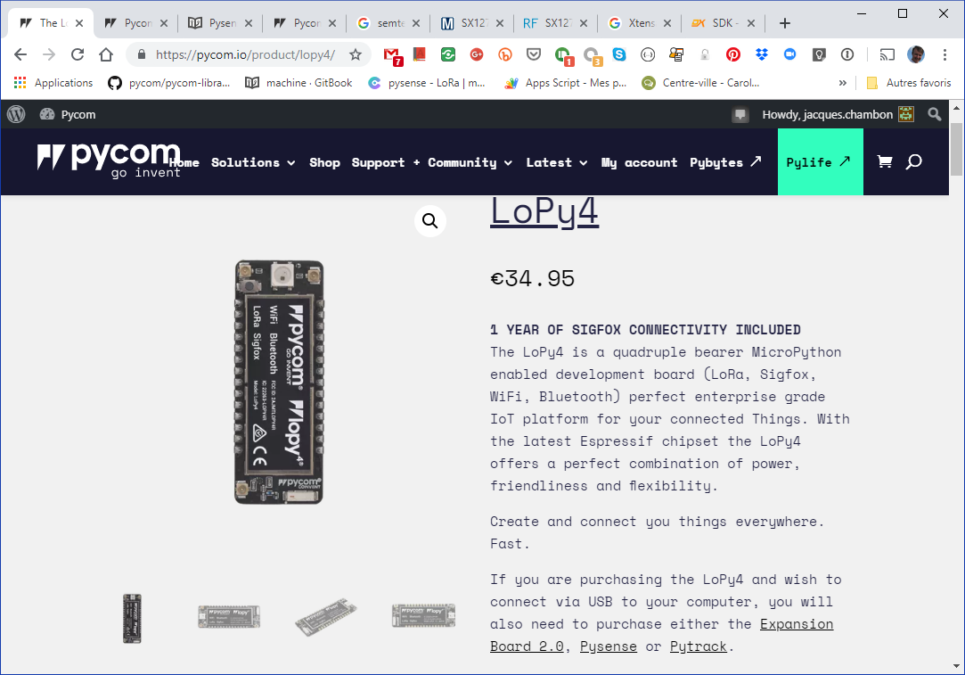

Slide 5
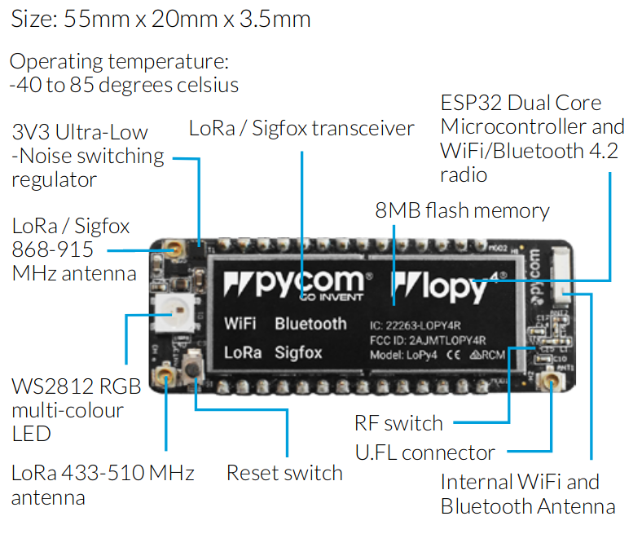

Slide 6
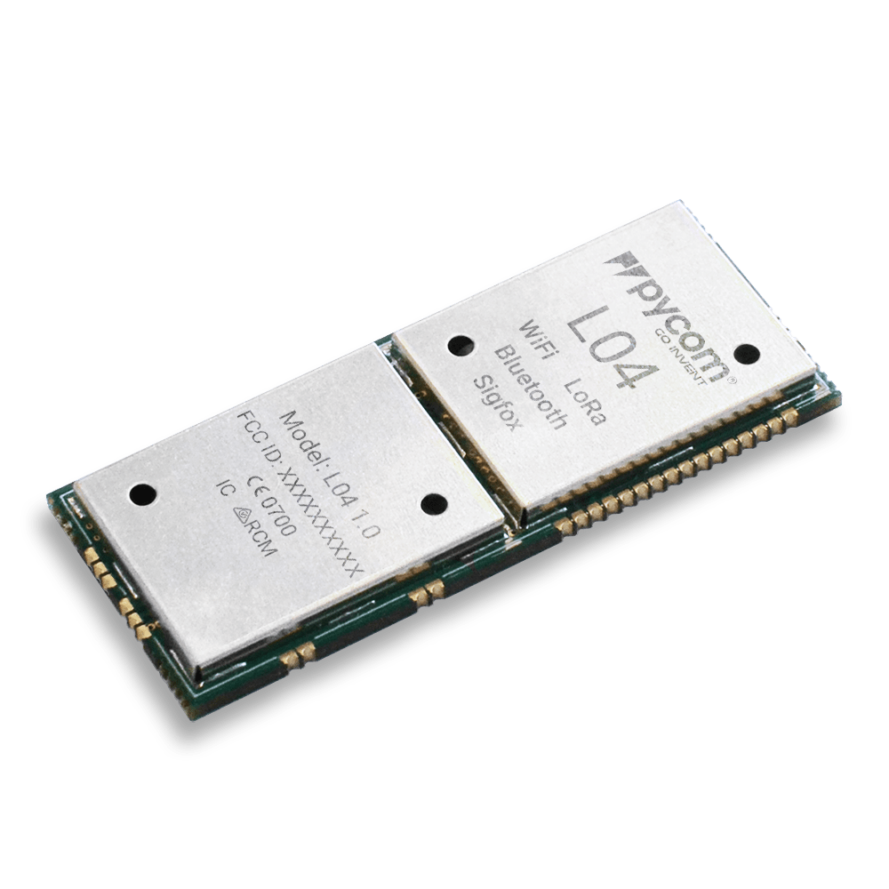
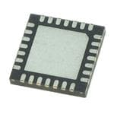
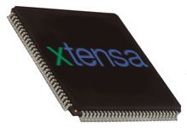
Semtech SX 1276
Espressif ESP32

Slide 7
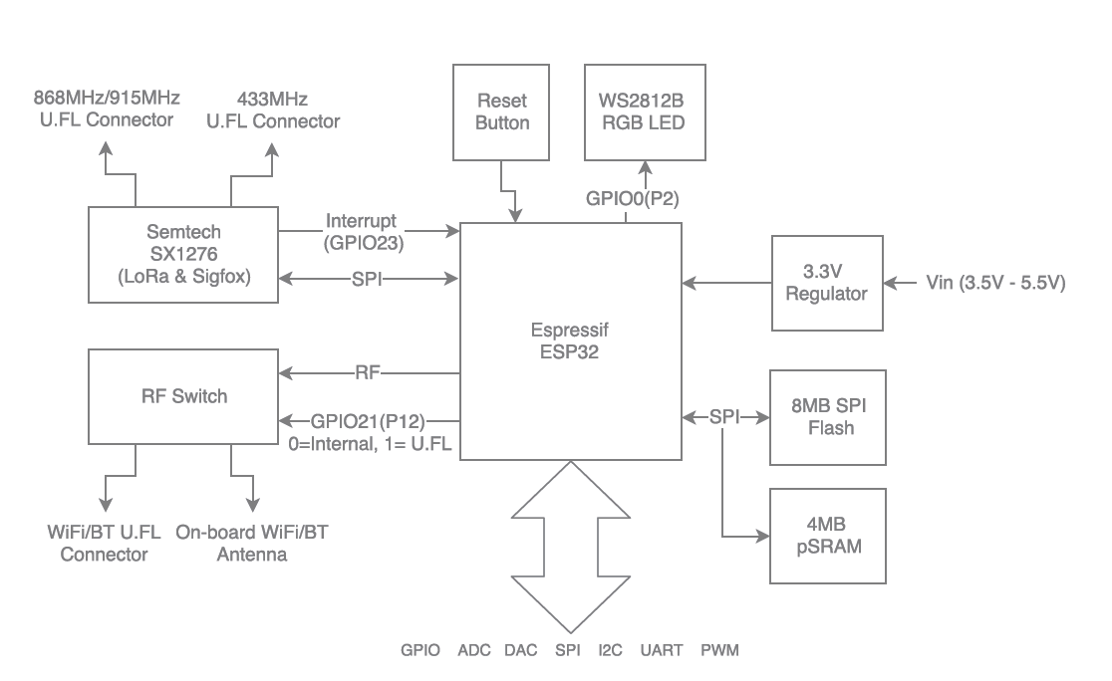

Slide 8
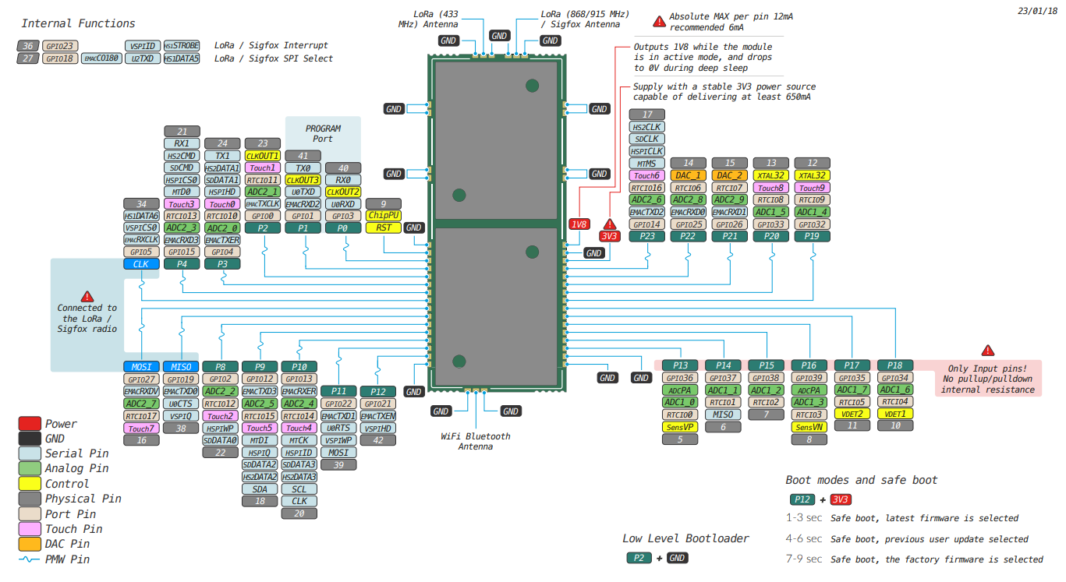

Slide 9
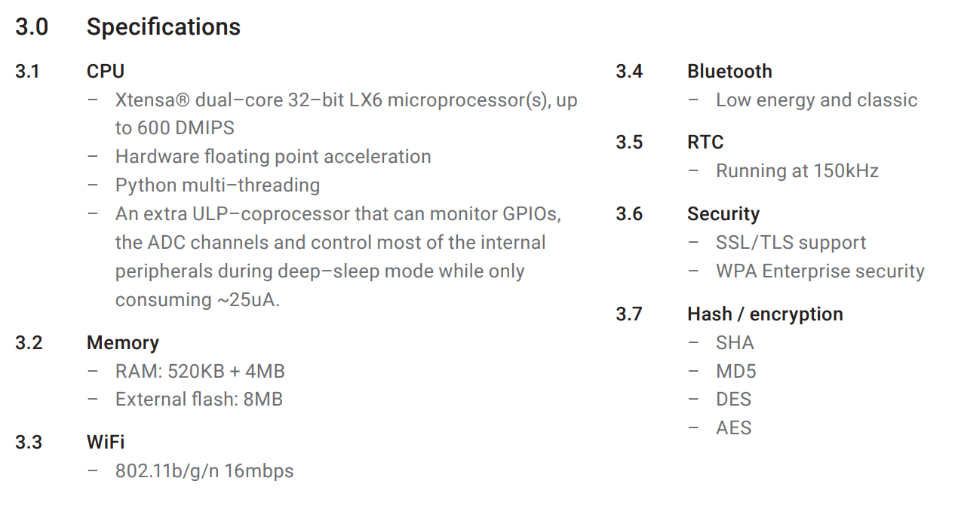

Slide 10
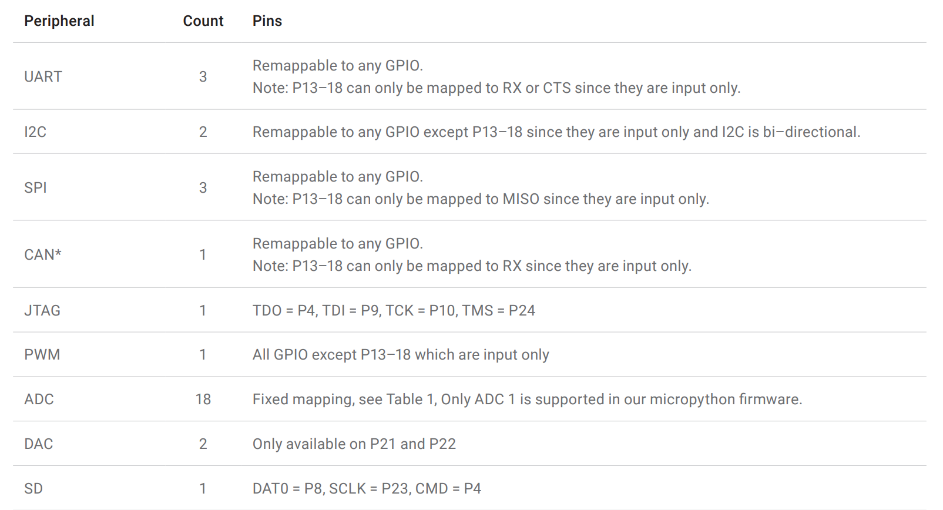

Slide 11
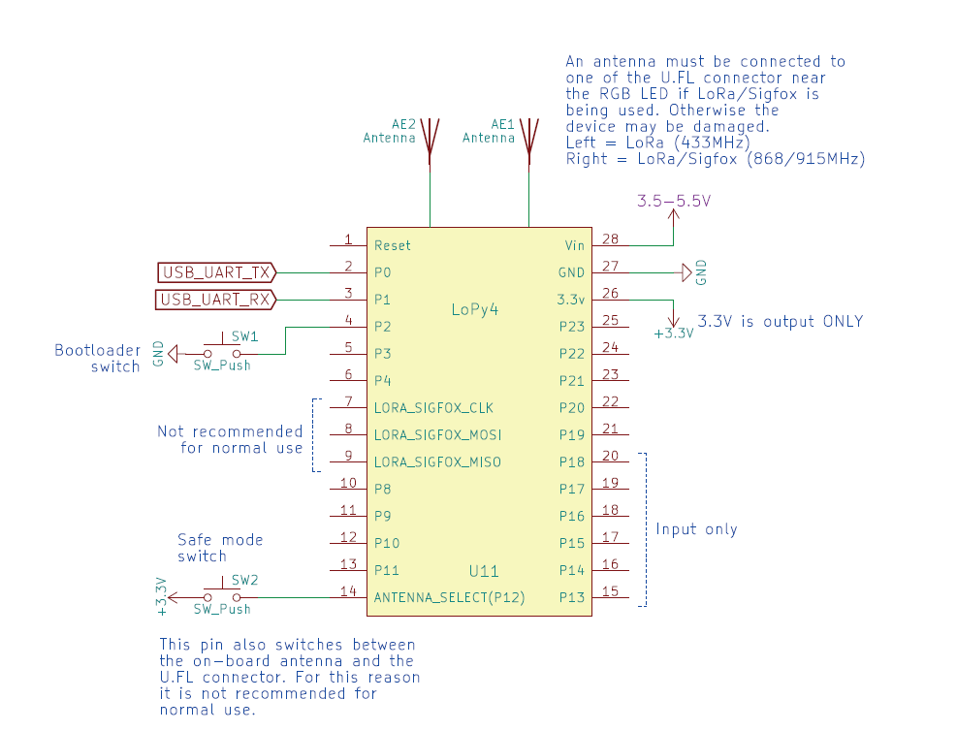

Slide 12
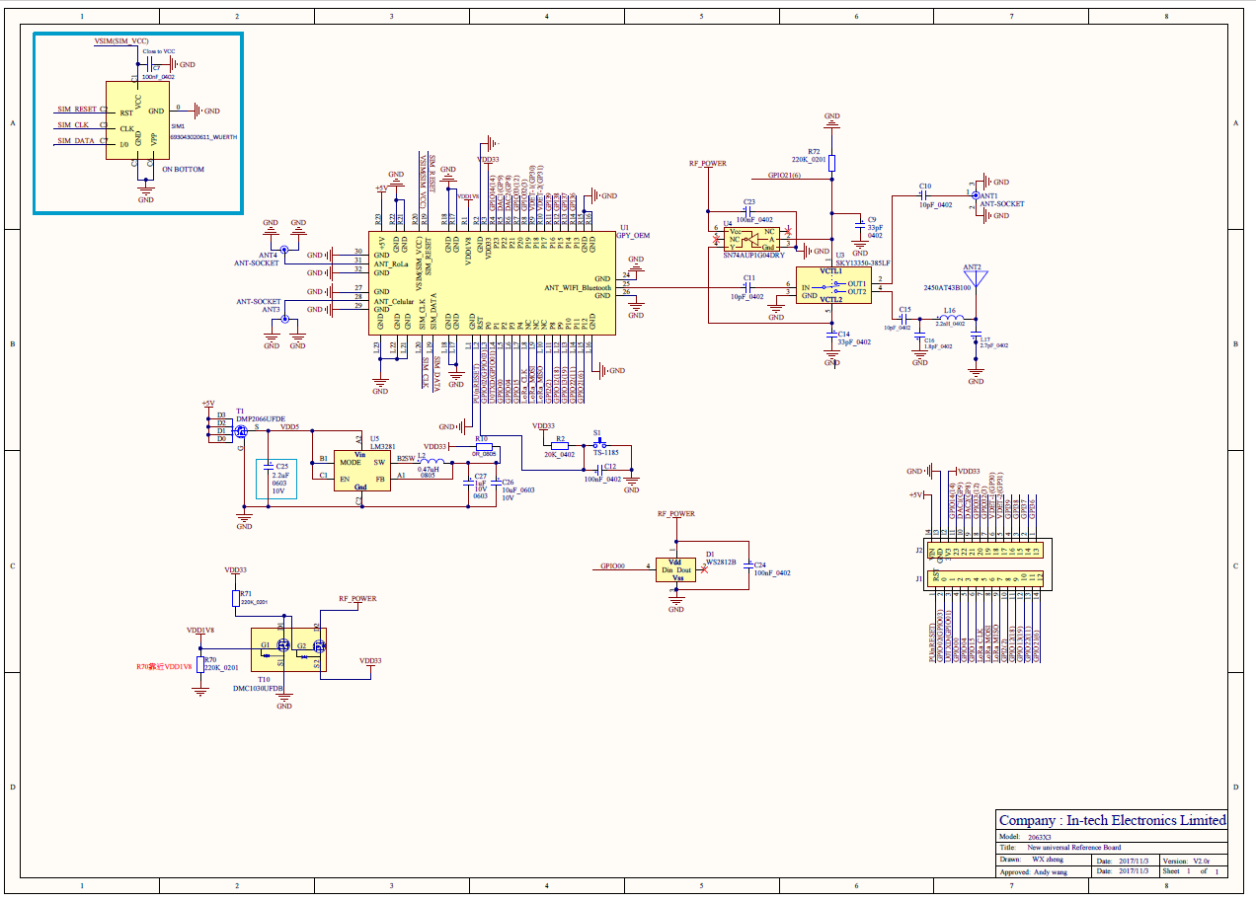

Slide 13
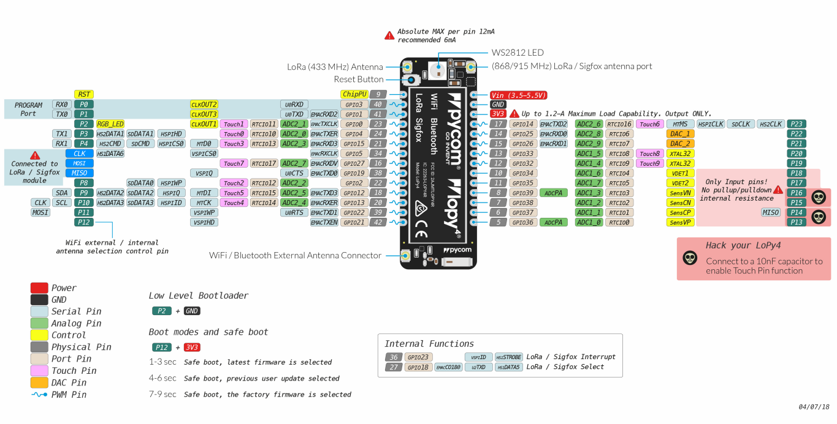

Slide 14
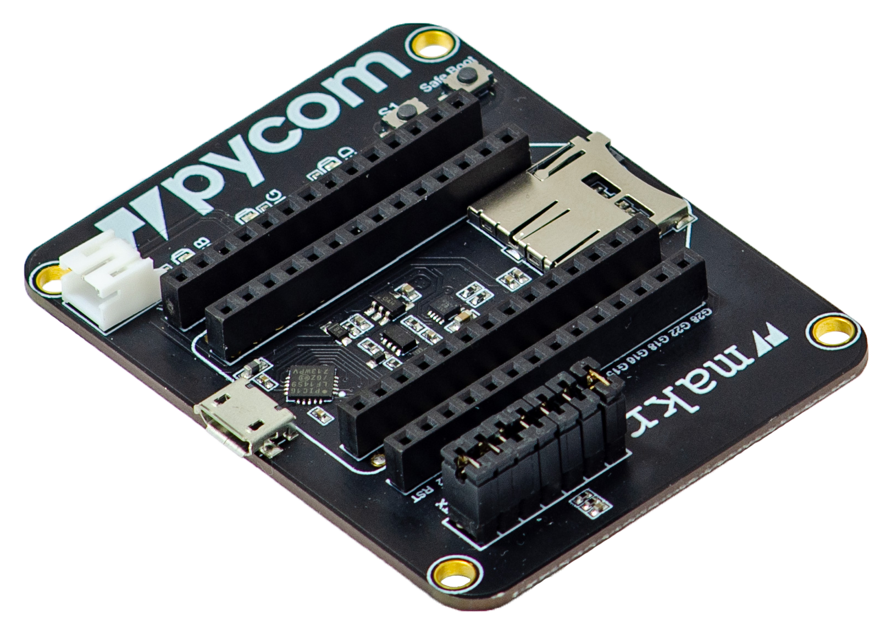

Slide 15
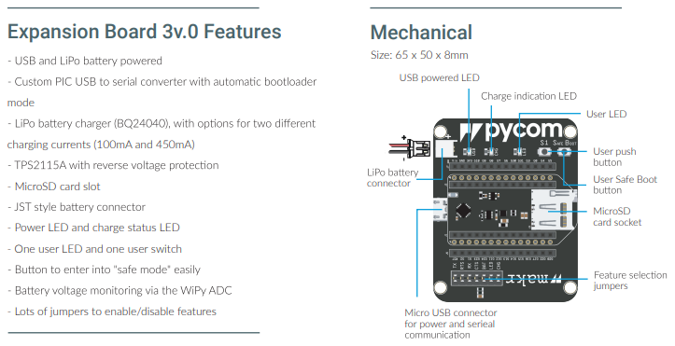

Slide 16
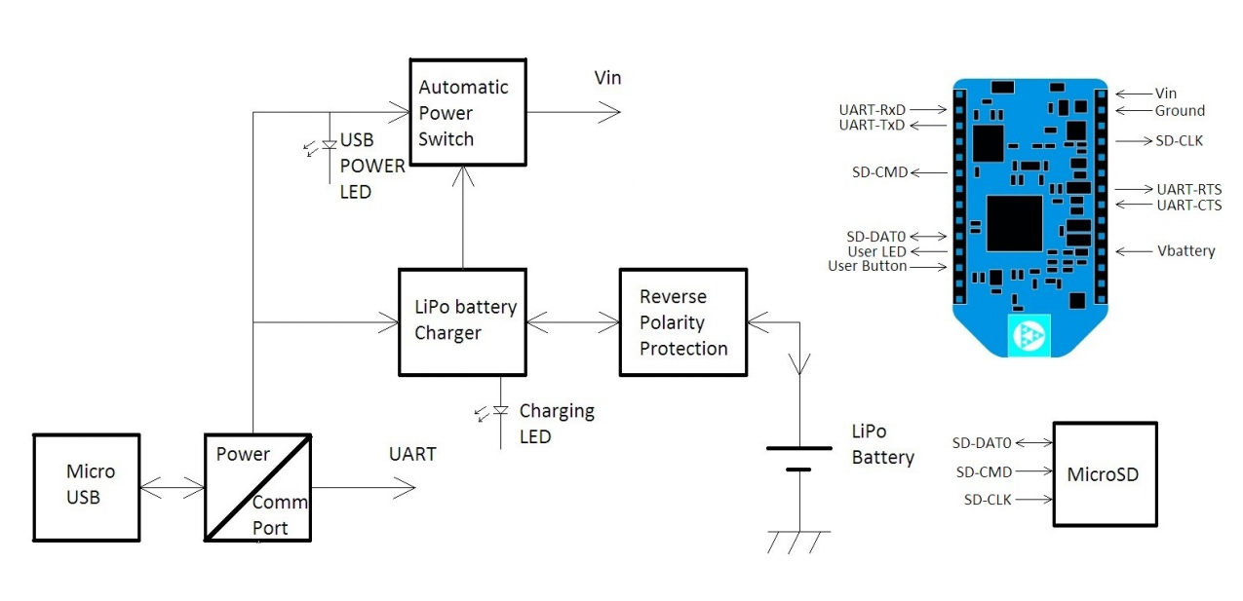

Slide 17
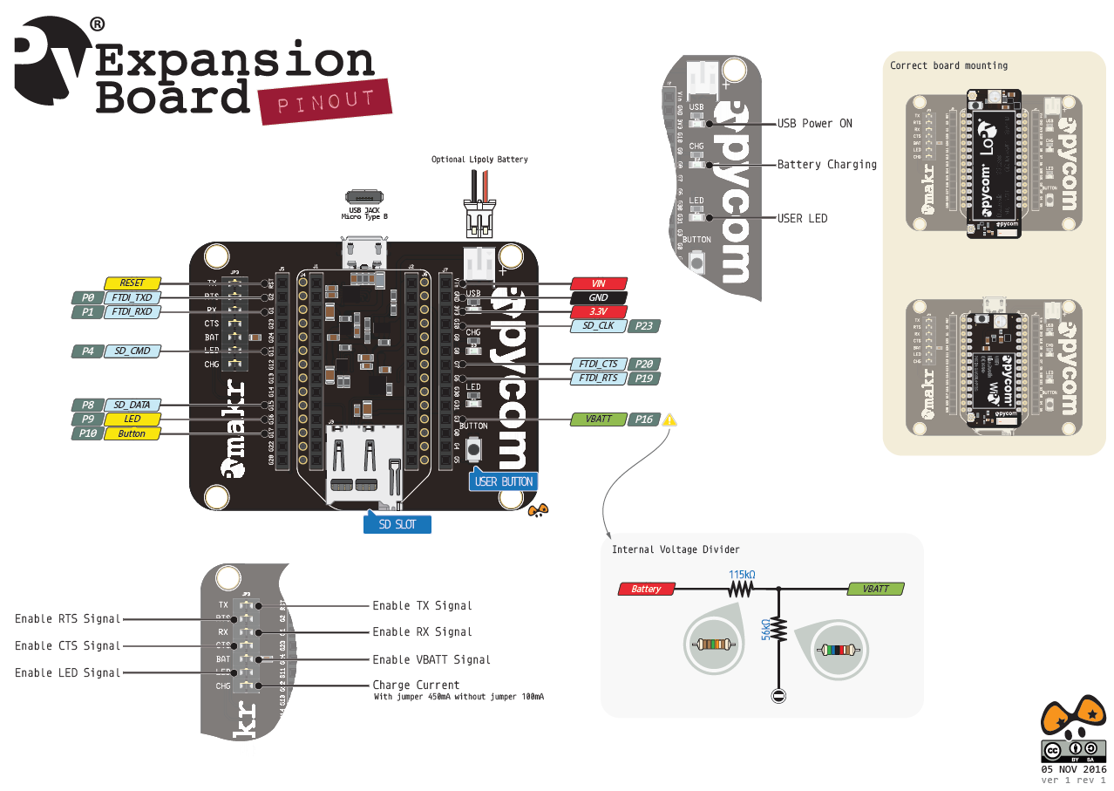
https://docs.pycom.io/.gitbook/assets/expansion2-pinout.pdf

Slide 18
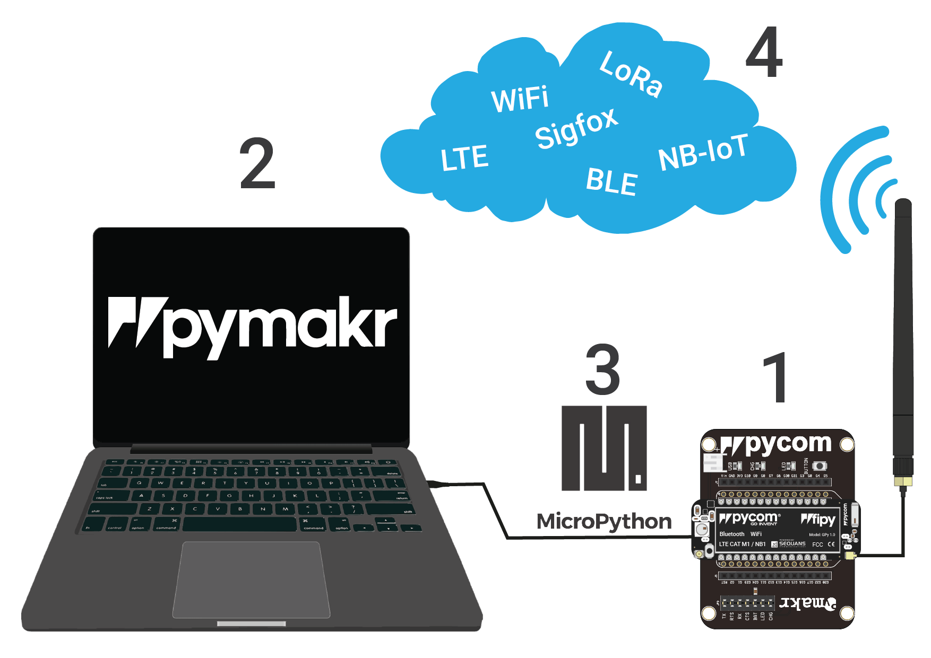

Slide 19
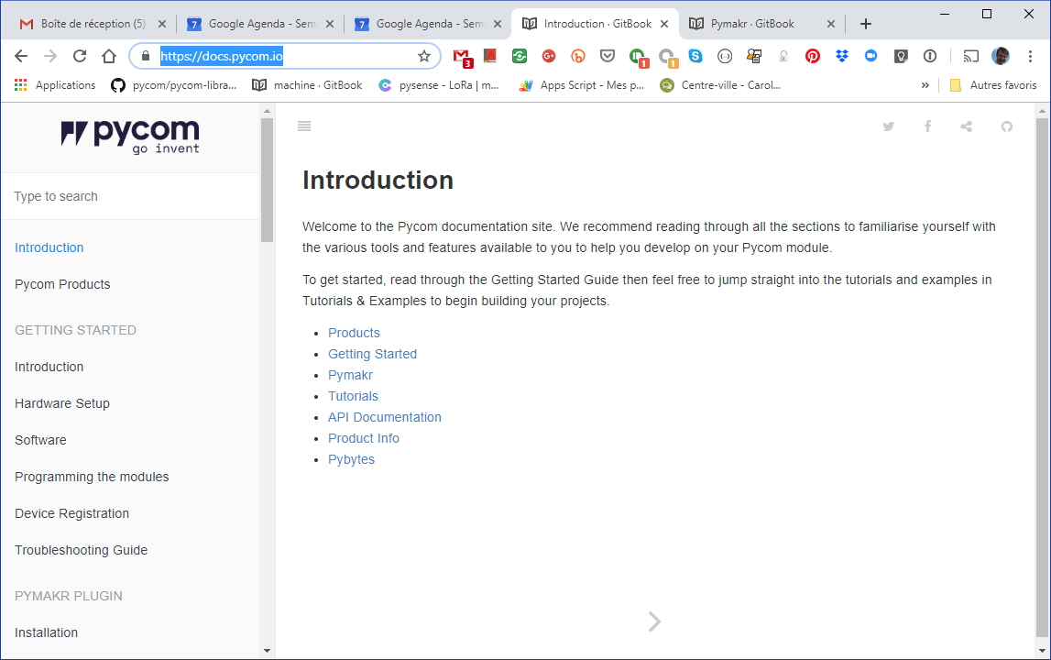
https://docs.pycom.io/

Slide 20
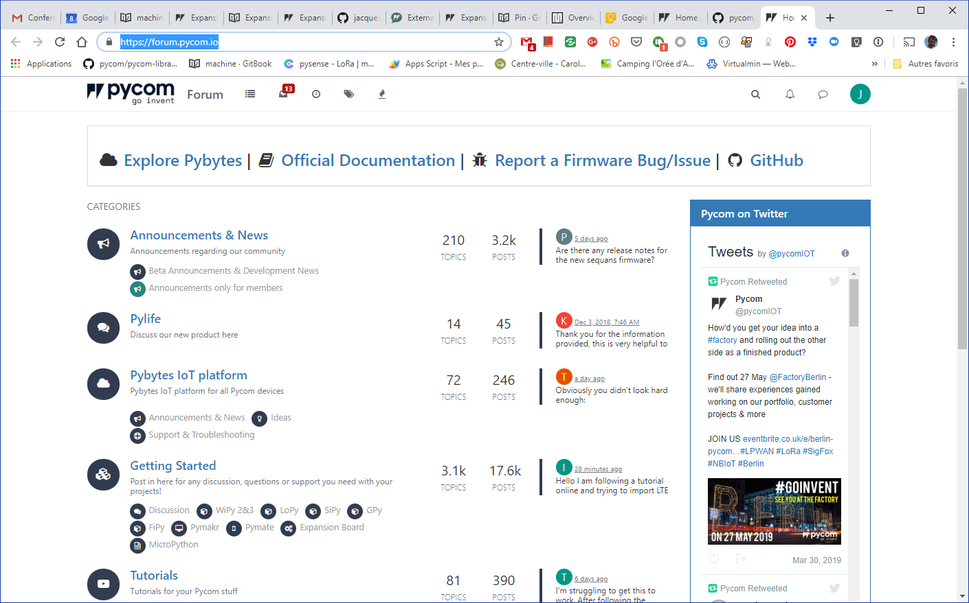
https://forum.pycom.io/

Slide 21

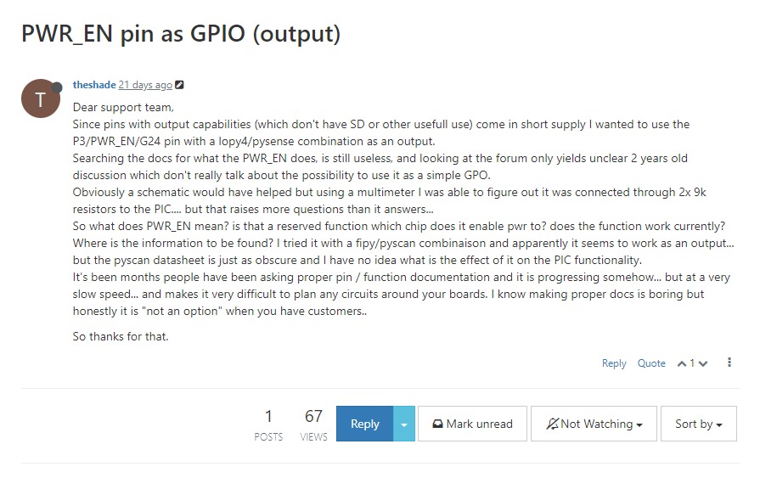
La documentation laisser parfois à désirer

Slide 22

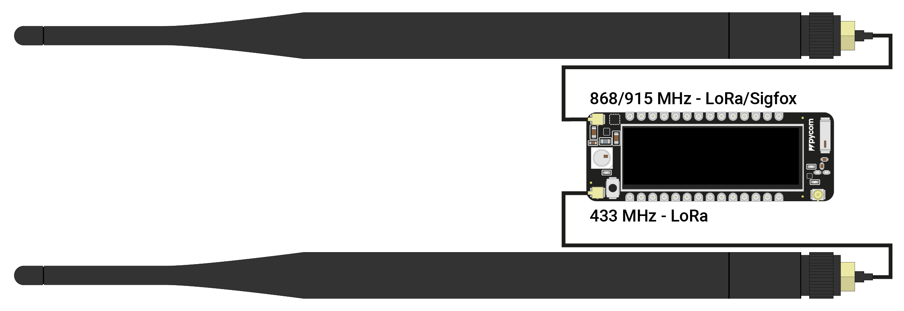
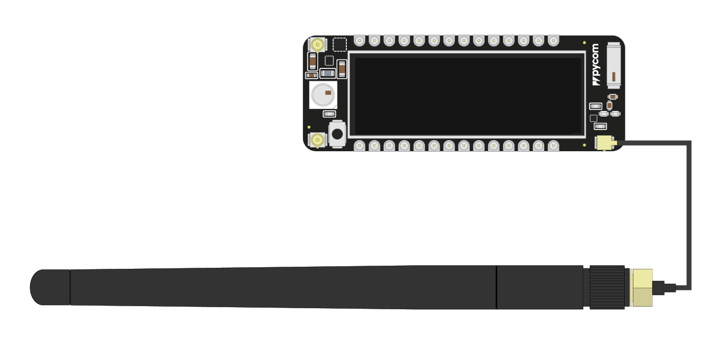
Option
Wifi

Slide 23
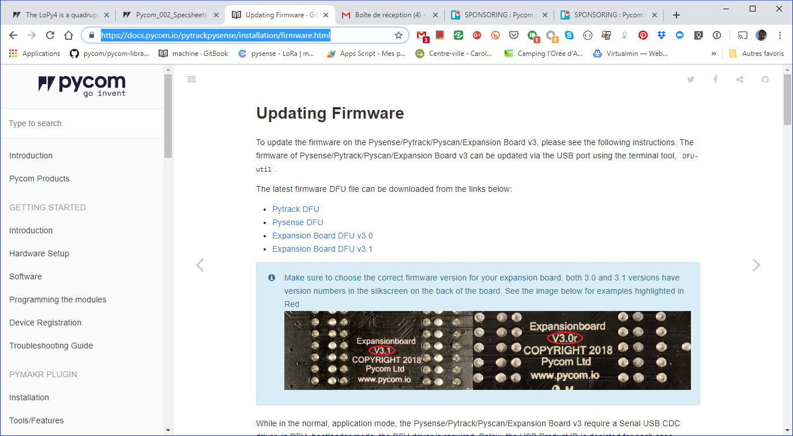
Avant d’insérer le Lopy4 sur la carte d’extension
https://docs.pycom.io/pytrackpysense/installation/firmware.html

Slide 24
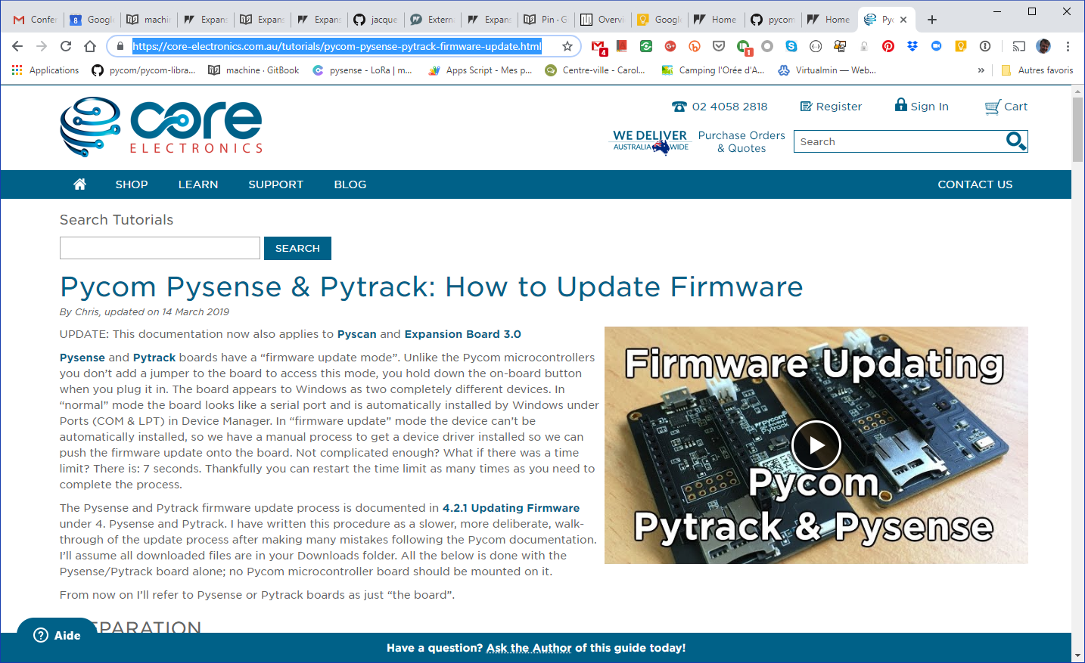
https://core-electronics.com.au/tutorials/pycom-pysense-pytrack-firmware-update.html

Slide 25
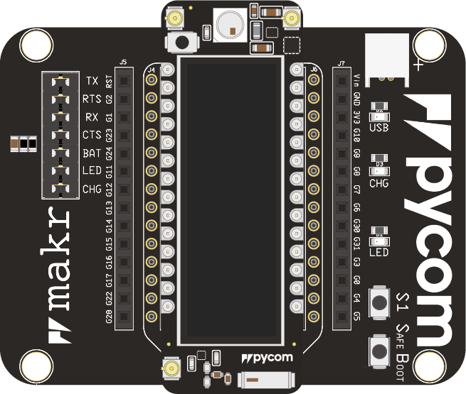

Slide 26
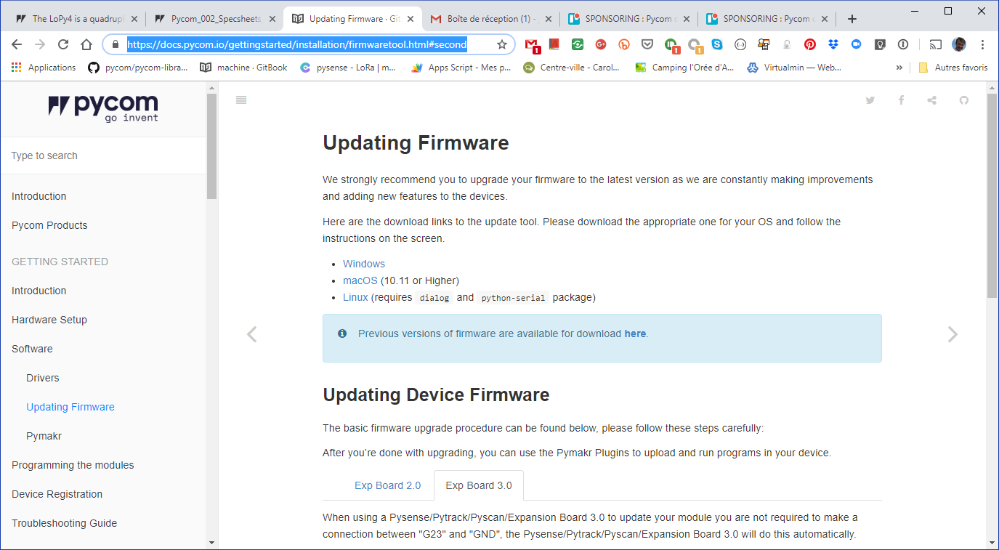
https://docs.pycom.io/gettingstarted/installation/firmwaretool.html#second

Slide 27
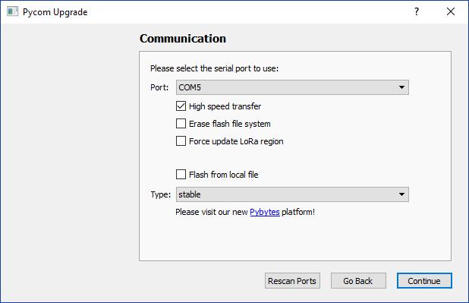

Slide 28
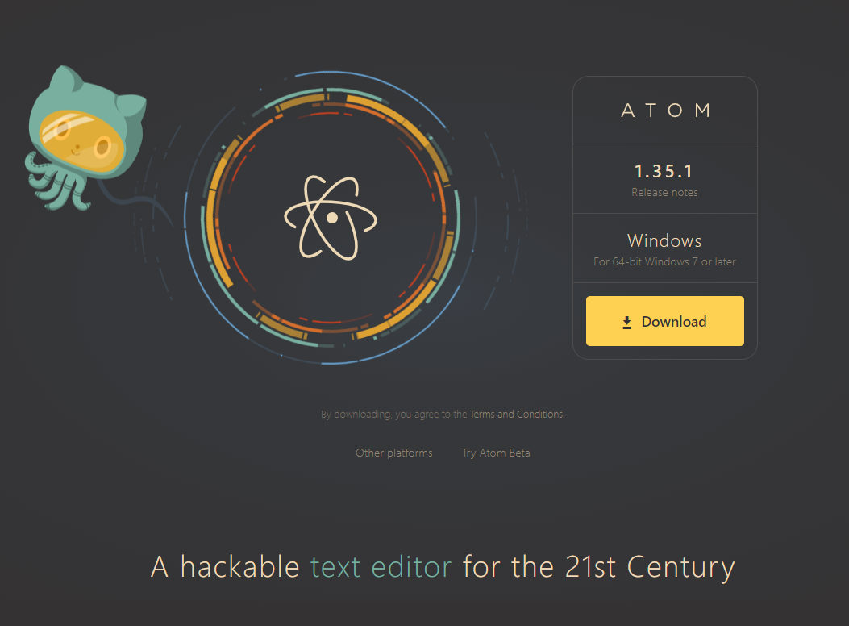
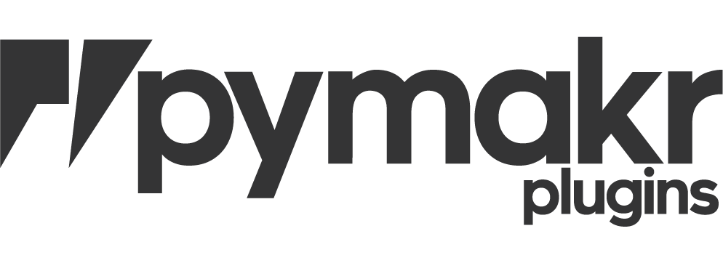
https://atom.io/
https://github.com/pycom/pymakr-atom/

Slide 29
Micropython
http://docs.micropython.org/en/latest/
Micropython is a lean and efficient implementation of the Python 3 programming language that includes a small subset of the Python standard library and is optimized to run on microcontrollers and in constrained environments.
Micropython is packed full of advanced features such as an interactive prompt, arbitrary precision integers, closures, list comprehension, generators, exception handling and more. Yet it is compact enough to fit and run within just 256k of code space and 16k of RAM.
Micropython aims to be as compatible with normal Python as possible to allow you to transfer code with ease from the desktop to a microcontroller or embedded system.
Micropython differences from CPython:
http://docs.micropython.org/en/latest/genrst/index.html

Slide 30
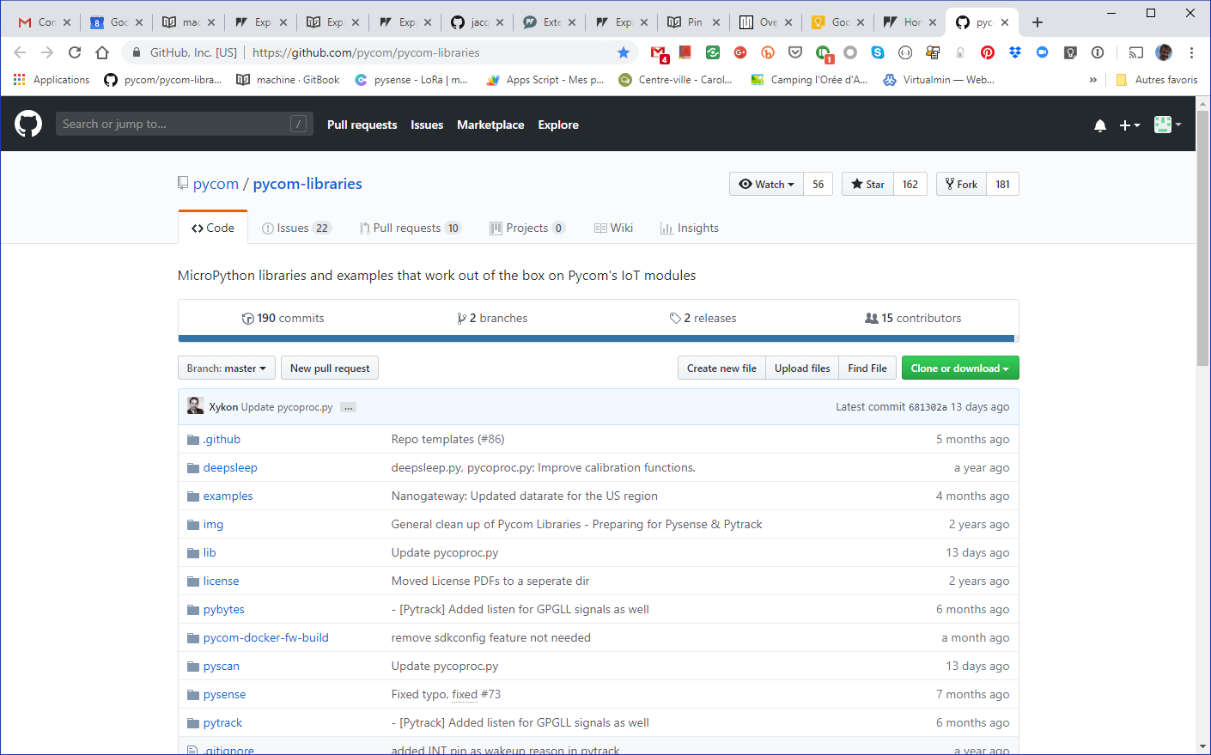
https://github.com/pycom/pycom-libraries

Slide 31
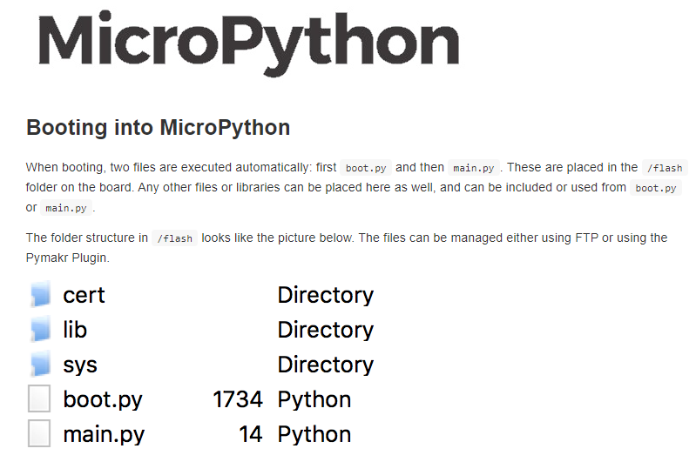

Slide 32
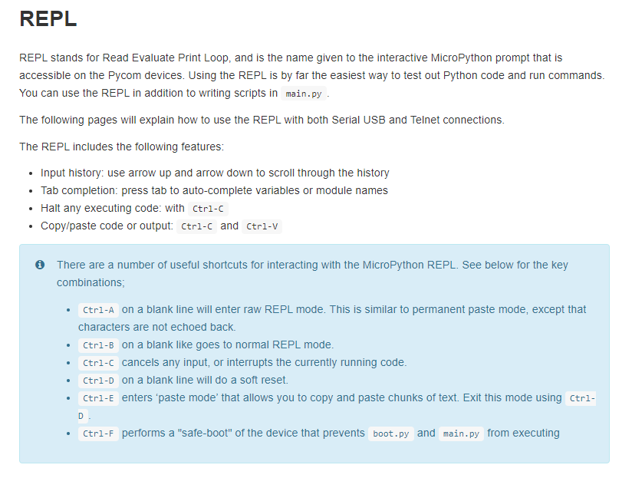

Slide 33
Reset
Safe
Boot

Slide 34
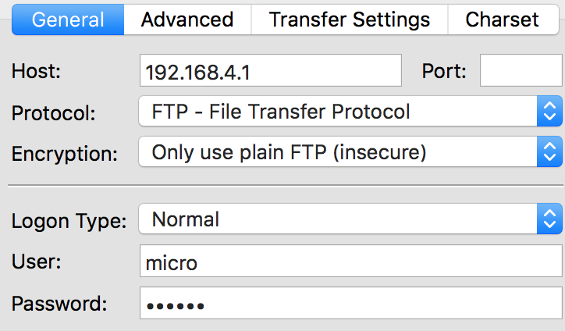
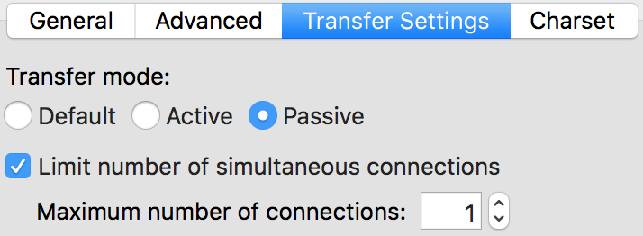

Slide 35
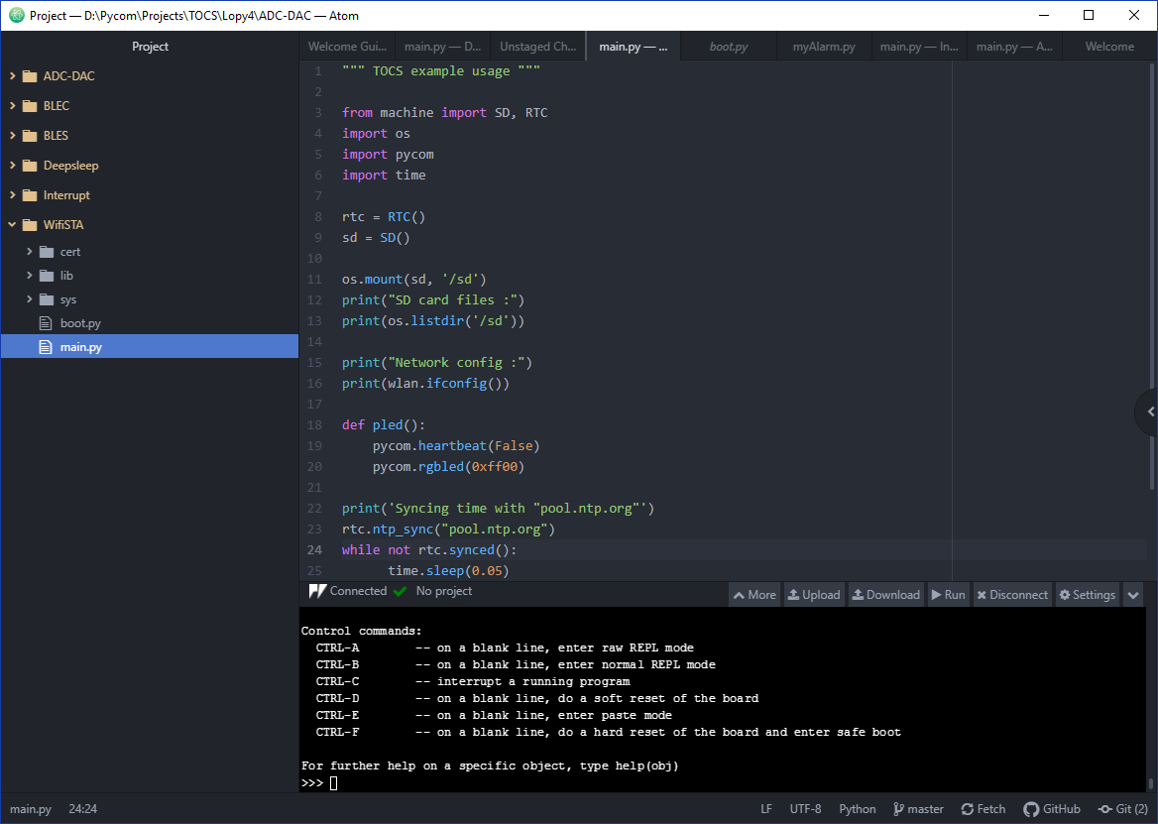

Slide 36
